Slide 1
Deep Learning In Robotic Vision Applications & Challenges
Ty Nguyen

Slide 2
Main Topics
Introduction
Vision-based Robotics Applications (Examples)
Visual Odometry
Object Detection & Segmentation for Inspection
Challenges
Resource Limitation
Real Time Inference
Sparse Inputs
Efficient Convolution
Dilated Convolution
Deformable Convolution
Continuous Convolution

Slide 3
Main Topics
Introduction
Vision-based Robotics Applications (Examples)
Visual Odometry
Object Detection & Segmentation for Inspection
Challenges
Resource Limitation
Real Time Inference
Sparse Inputs
Efficient Convolution
Dilated Convolution
Deformable Convolution
Continuous Convolution

Slide 4
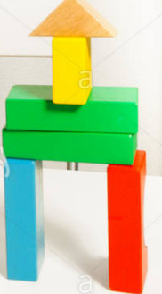

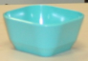
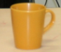
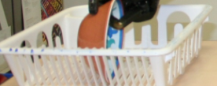

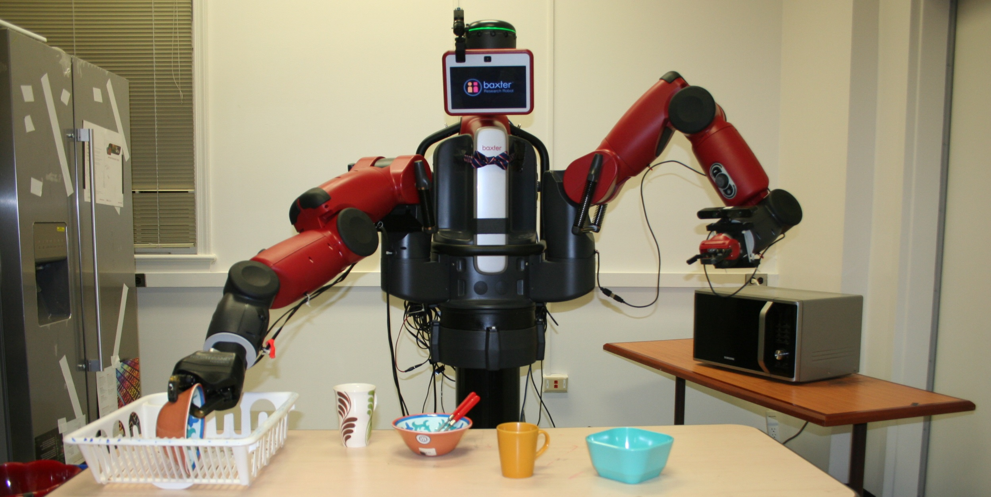
Introduction: Humans vs Robots
Environment
Environment
Changing environment through interaction
Sensory signals from the environment
Changing environment through interaction
Sensory signals from the environment
https://www.researchgate.net/profile/Chris_Christou3/publication/272677840/figure/fig1/AS:294921811578882@1447326247365/The-Perception-Action-loop.png
https://c8.alamy.com/comp/EWXGT8/cute-boy-putting-blocks-replicating-example-EWXGT8.jpg
https://www.researchgate.net/profile/Tim_Ireland/publication/237191550/figure/fig5/AS:299381313032206@1448389475951/Perception-action-is-a-loop-describing-agent-behaviour.png

Slide 5
Introduction: Humans vs Robots
Like humans, robots use perception signals as input to interact with the environment and execute tasks
Environment
Environment
Changing environment through interaction
Sensory signals from the environment
Changing environment through interaction
Sensory signals from the environment
https://www.researchgate.net/profile/Chris_Christou3/publication/272677840/figure/fig1/AS:294921811578882@1447326247365/The-Perception-Action-loop.png
https://c8.alamy.com/comp/EWXGT8/cute-boy-putting-blocks-replicating-example-EWXGT8.jpg
https://www.researchgate.net/profile/Tim_Ireland/publication/237191550/figure/fig5/AS:299381313032206@1448389475951/Perception-action-is-a-loop-describing-agent-behaviour.png

Slide 6
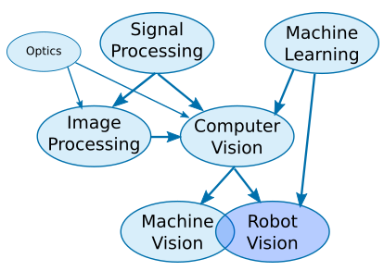
Robotic Vision IS NOT Simply Machine Vision!
Without Robotic Vision, your robot is essentially blind
Robotic Vision involves using a combination of camera hardware and computer algorithms to allow robots to process visual data from the world.

Slide 7
Main Topics
Introduction
Vision-based Robotics Applications (Examples)
Visual Odometry
Object Detection & Segmentation for Inspection
Challenges
Resource Limitation
Real Time Inference
Sparse Inputs
Efficient Convolution
Dilated Convolution
Deformable Convolution
Continuous Convolution

Slide 8
Deep Learning for Vision Odometry 1

Slide 9
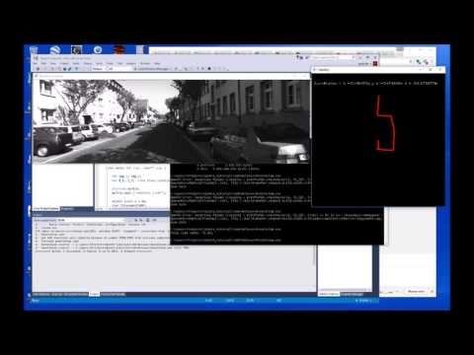
UnDeepVO: Monocular Visual Odometry
through Unsupervised Deep Learning
Li, R., Wang, S., Long, Z. and Gu, D., 2018, May. Undeepvo: Monocular visual odometry through unsupervised deep learning. In 2018 IEEE International Conference on Robotics and Automation (ICRA) (pp. 7286-7291). IEEE.
What is Odometry? • The Greeks invented it… “Route Measure” • Answer the question: “Where am I”
What is Visual Odometry?
• Estimating the motion in real time using sequential images (i.e., egomotion)
• The idea was first introduced for planetary rovers operating on Mars – Moravec 1980

Slide 10
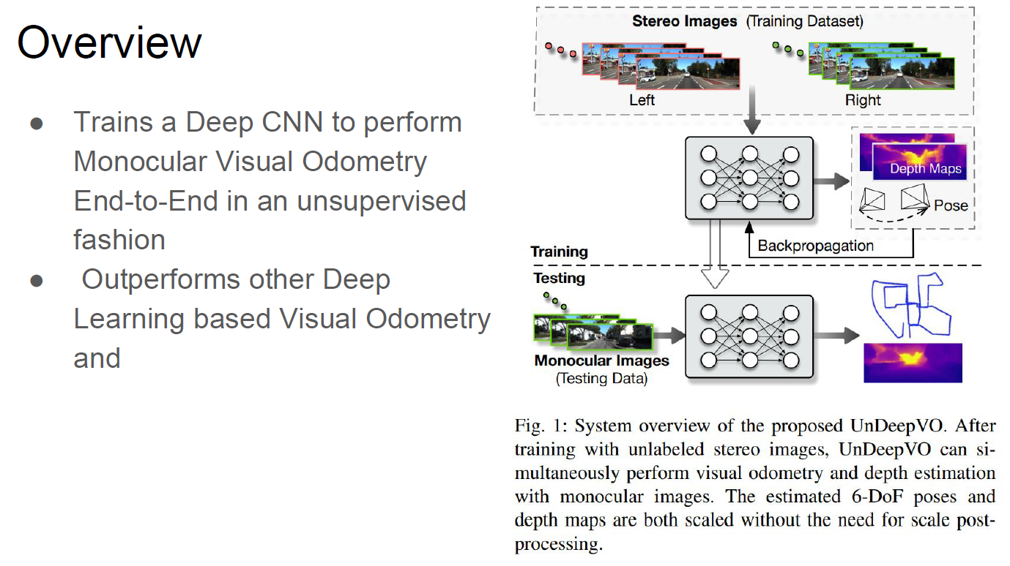

Slide 11
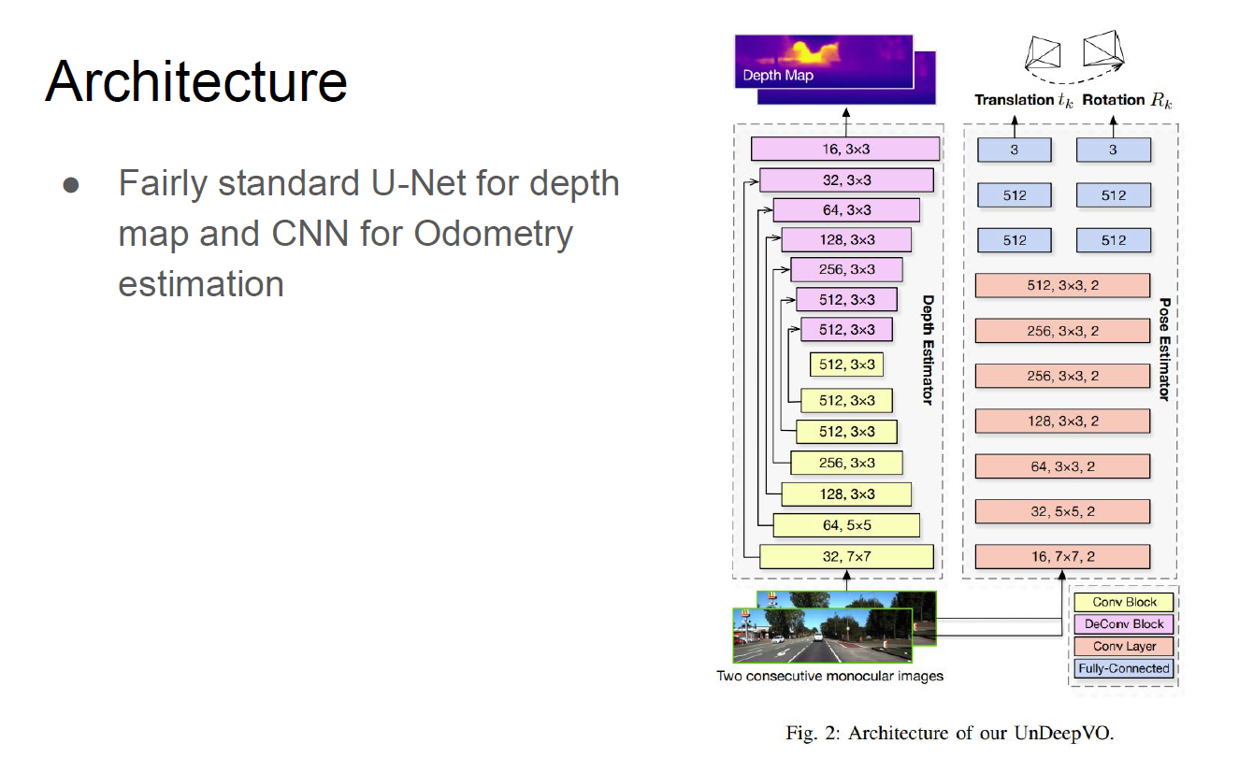

Slide 12
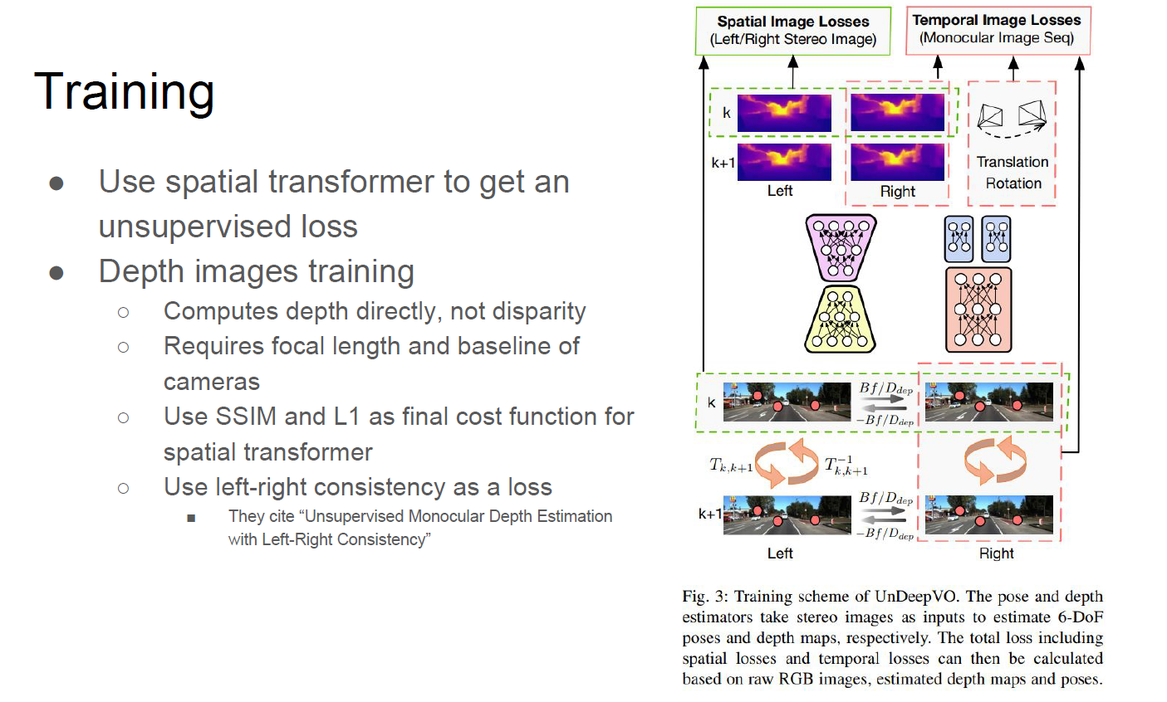

Slide 13
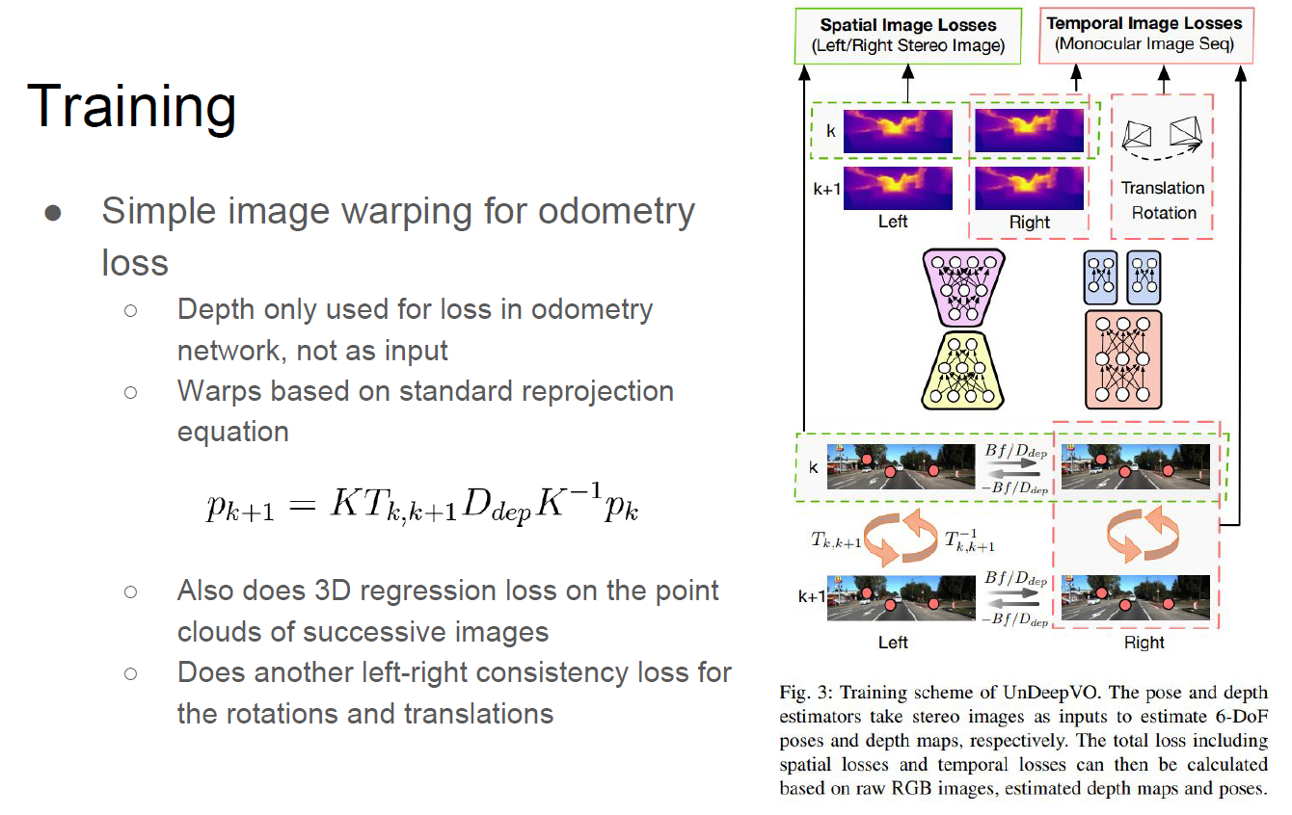

Slide 14
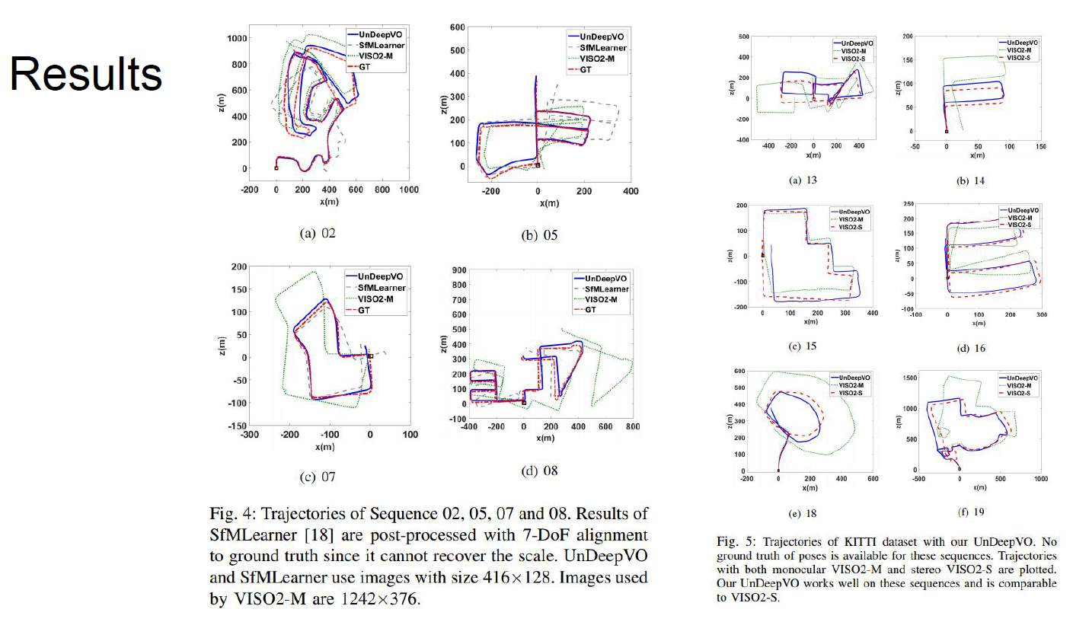

Slide 15
Deep Learning for Vision Odometry 2

Slide 16
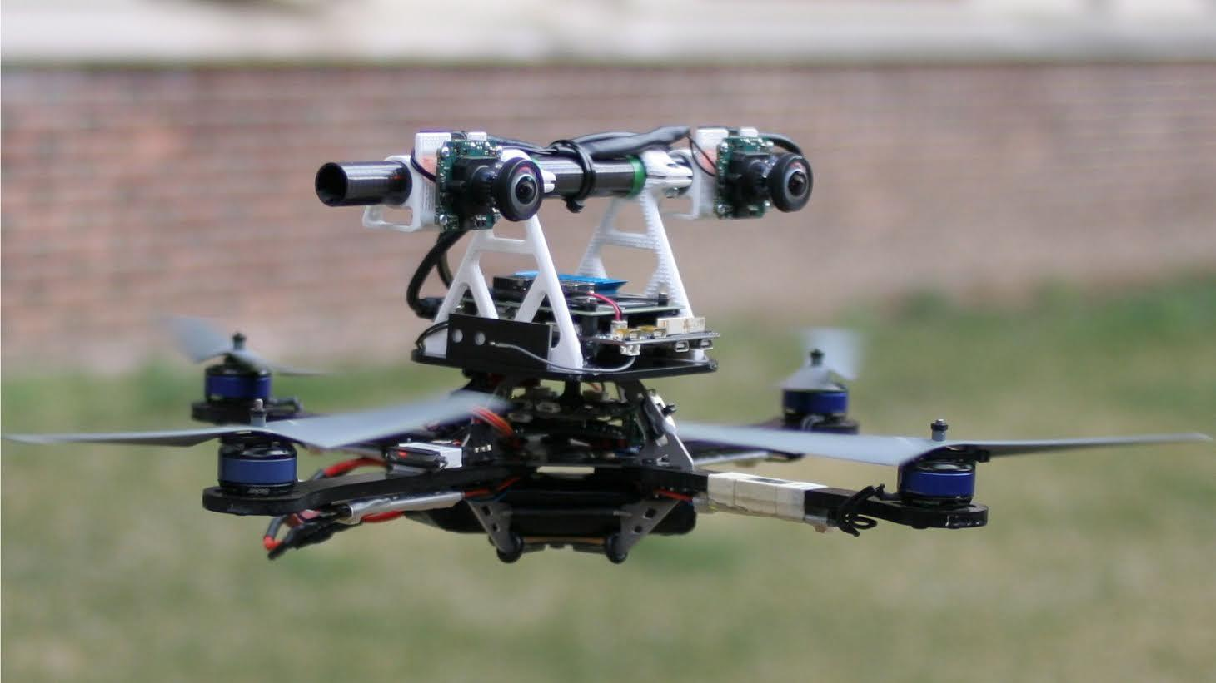
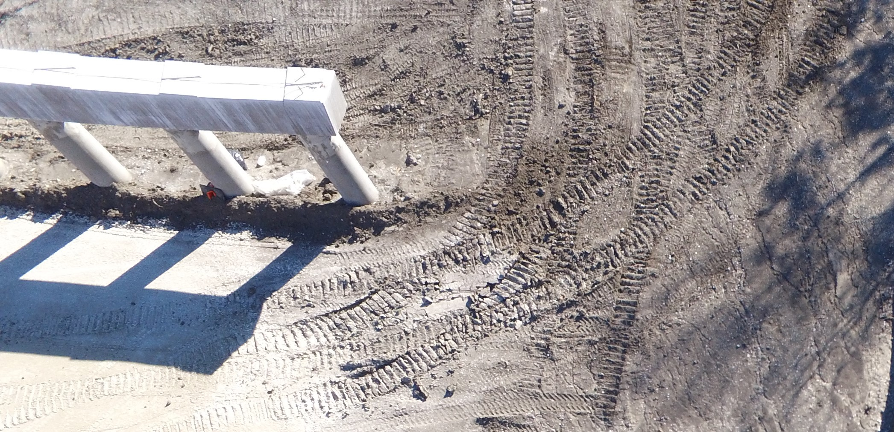
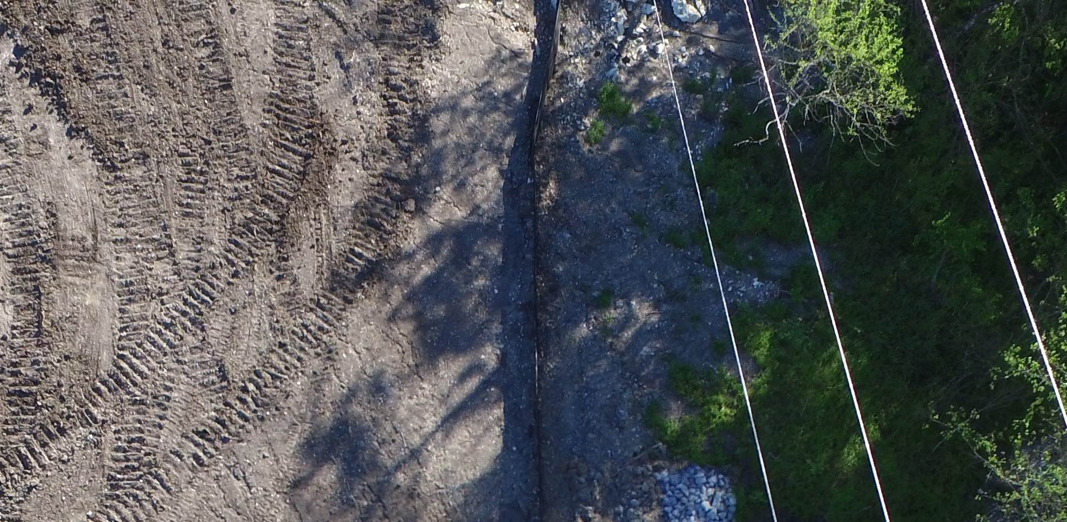
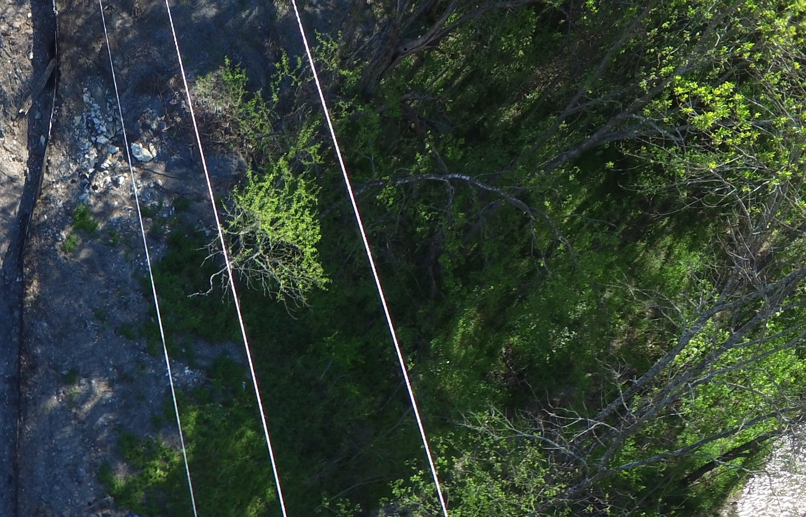
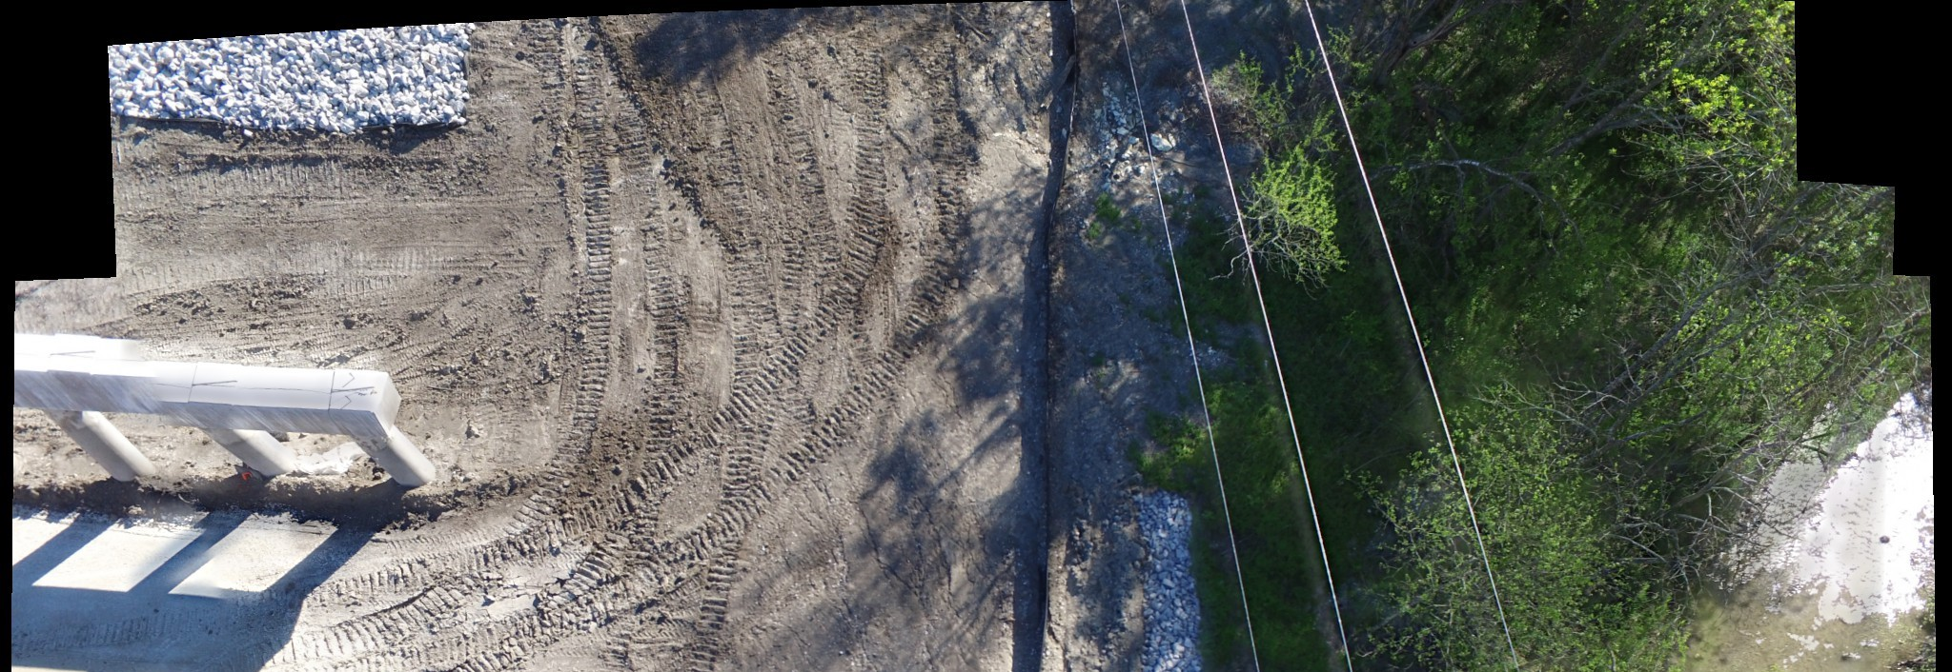
Robust Homography Estimation for Vision-based Inspection Using Aerial Images
Nguyen, T., Chen, S.W., Skandan, S., Taylor, C.J. and Kumar, V., 2018. Unsupervised Deep Homography: A Fast and Robust Homography Estimation Model. IEEE Robotics and Automation Letters.
Motivation: Vision-based Inspection Using Aerial Images
2. These images could be inspected individually (i.e. damage identification, structure inspection..)
1. Fly a drone with high resolution cameras attached to capture high quality aerial images with sufficient overlapping
3. Stitch individual aerial images to create a view of entire landscape

Slide 17
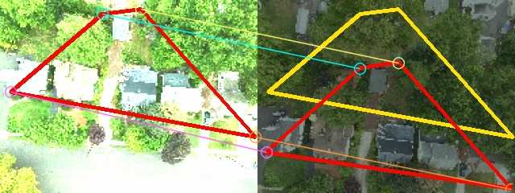
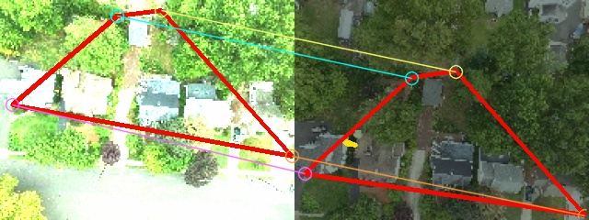
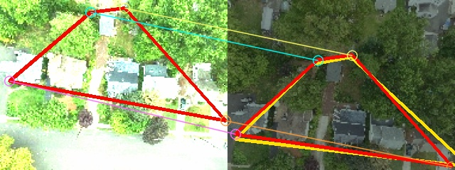
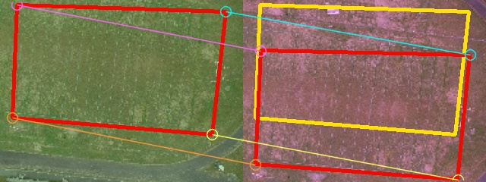
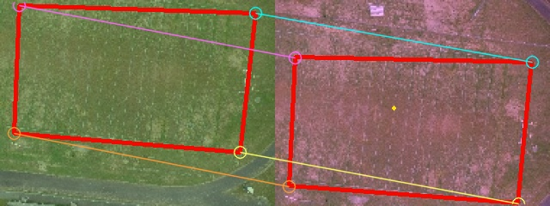
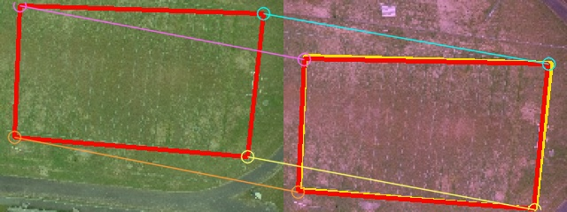
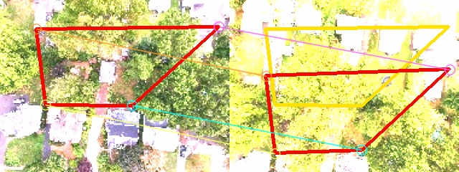
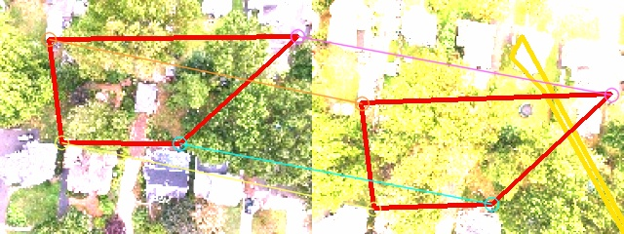
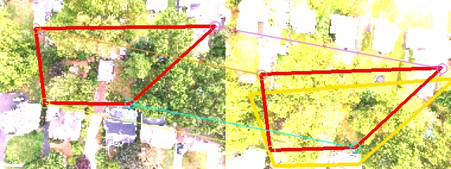
Direct
SIFT
Ours
Case 1: Illumination changes
Case 2: Low-texture
Case 3: Noise
Notes:
What’s wrong with traditional homography methods?
For example, consider the problem of finding the homography inducing by correspondences between a pair of images. Red represents the ground truth correspondences
Yellow represents the estimated correspondences.
In the first case, direct & SIFT method struggle with large illumination change.
In the second case, it is also observed the failure of two methods when images have low-texture.
In the 3rd case, when noises are largely injected, the two perform poorly too.
We propose a method to solve these problems.

Slide 18
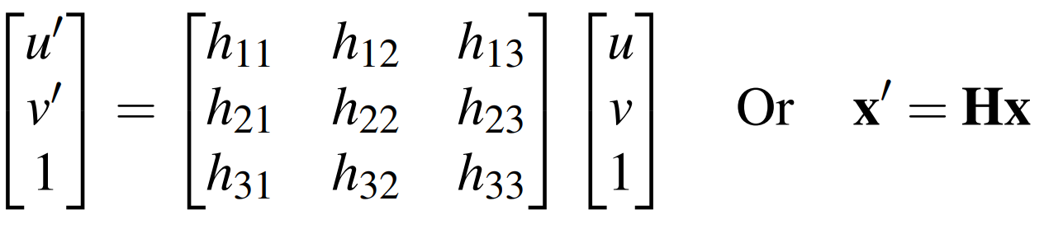
Problem Formulation
Focus on step 3: finding the transformation from one image to its successive image (image registration), to align them
Assumptions:
There is sufficient overlap between images (>=65%)
Only deal with images that are planar i.e. the real-world distance between different objects in the image is be small compared to the distance of the objects to the camera plane
Images can be registered using homographic mapping (the transformation from one image to the other can be viewed as consisting only of translation, rotation and scaling)
Estimate non-singular matrix H (3x3 matrix) s.t.

Slide 19

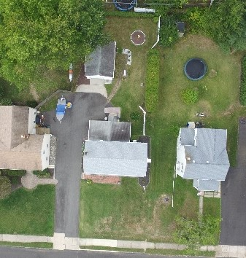
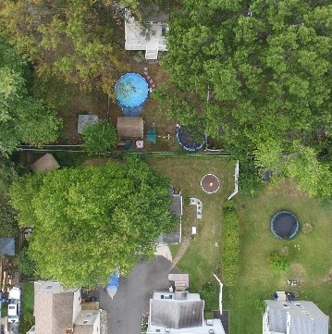
End-to-End Deep Learning Homography Regression
Ground truth of 4point
-parameterization of Homography
Stack two patches and feed into the network
Regression Output
Unsupervised
Regression Network
(CNN + FC)
4point
-parameterization of Homography
Mapping
Output
Backpropagation
Speed 50 fps (on CPU, batch size = 50)
Photometric Loss
Warp 1st patch
Compare 2nd patch
Notes:
Matrix is 3x3, ignoring 1 => 8 parameters
Loss function: intensity values (L1 loss)
Put as inference all blocks
One result slide
Our approach requires no ground truth, making it suitable for robotics applications.
The alternative solution here is to use the brightness consistency between the two images to obtain the signal to train the network.
In details, we first convert the 4point parameterization into the matrix form. From that, we warp the first patch using this matrix form before comparing with the second patch to obtain
Photometric loss to train the network.
Our approach takes advantage of a hybrid approach: use convolutional layers to extract image features from which we regress the homography and using
Photometric loss as in direct methods to train the network in an end-to-end manner.

Slide 20
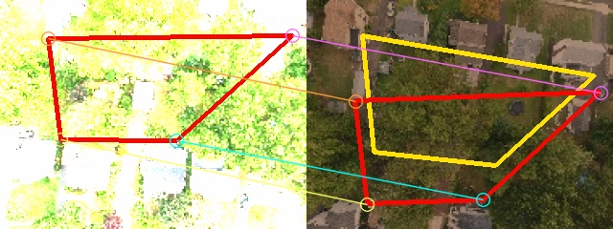
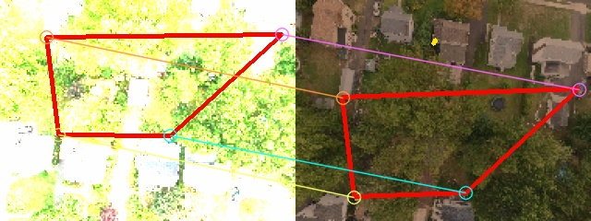
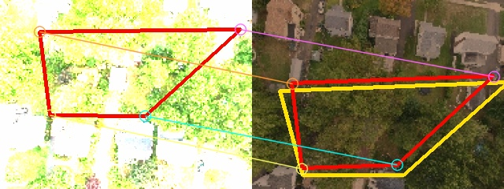
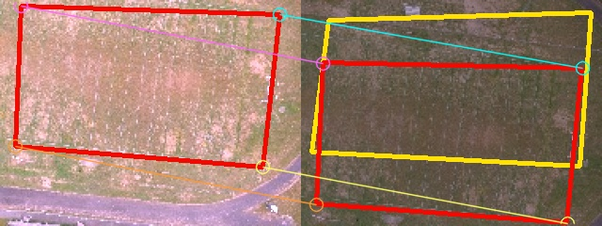
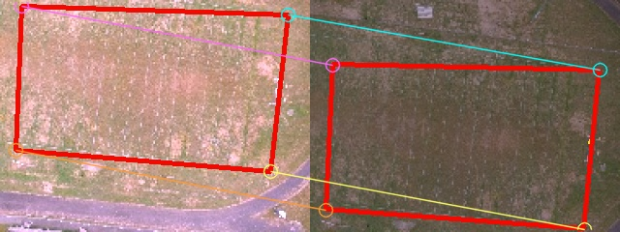
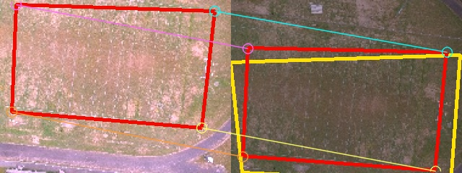
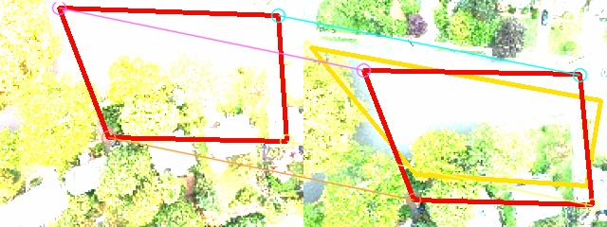
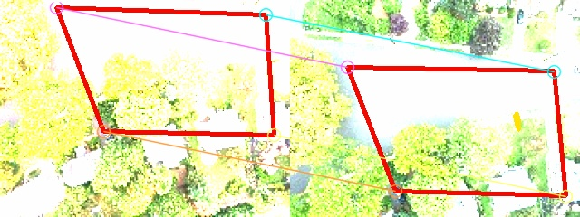

Direct
SIFT
Ours
Case 1: Illumination changes
Case 2: Low-texture
Case 3: Noise
Notes:
Some more examples showing our outperformance over reference methods in aerial image dataset.

Slide 21
Deep Learning for Object Inspection

Slide 22

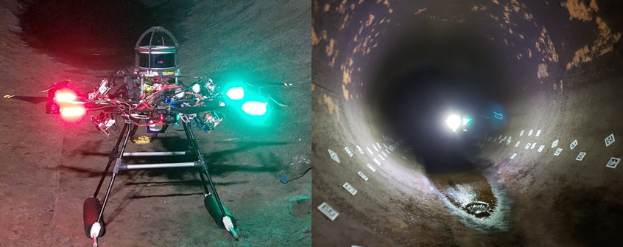
Vision-based Penstock Inspection
Penstock’s internal surface. External light is only used for showing drone & NOT available during image capturing
Autonomous drone used to capture images
Problem: identify corrosion on the internal surface of a penstock
Notes:
Briefly explain why need inspect

Slide 23
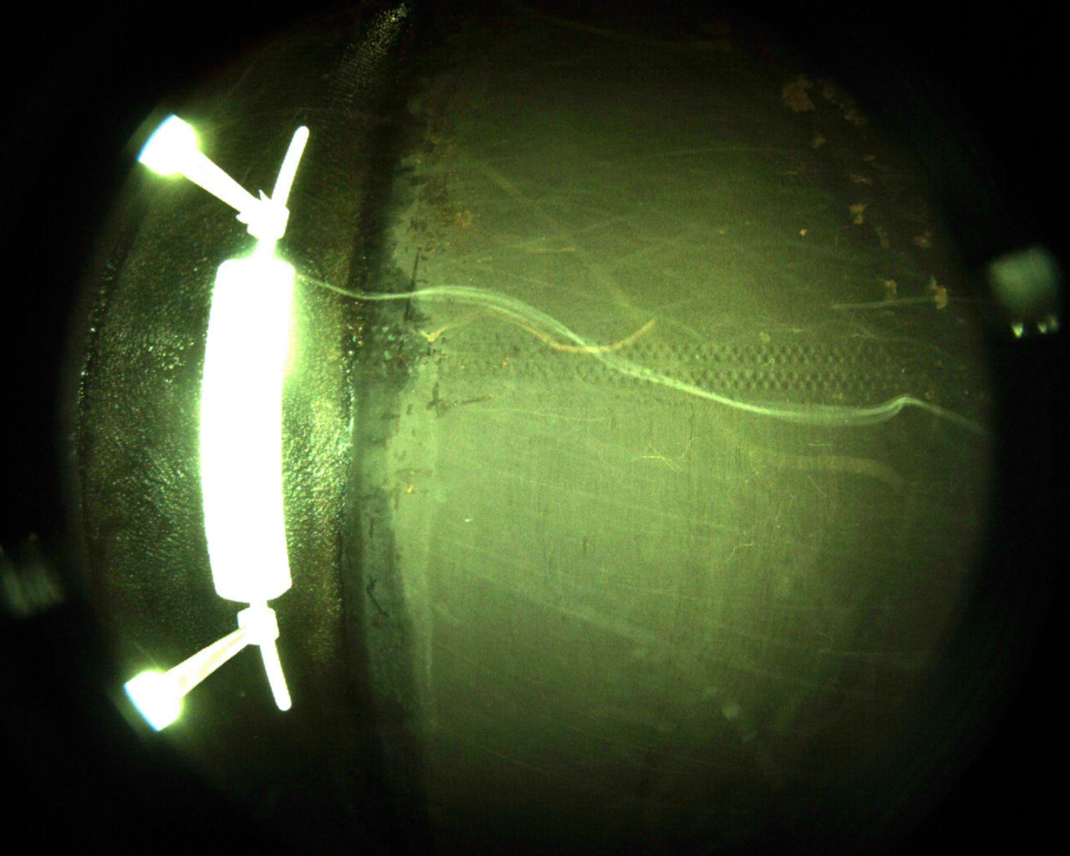
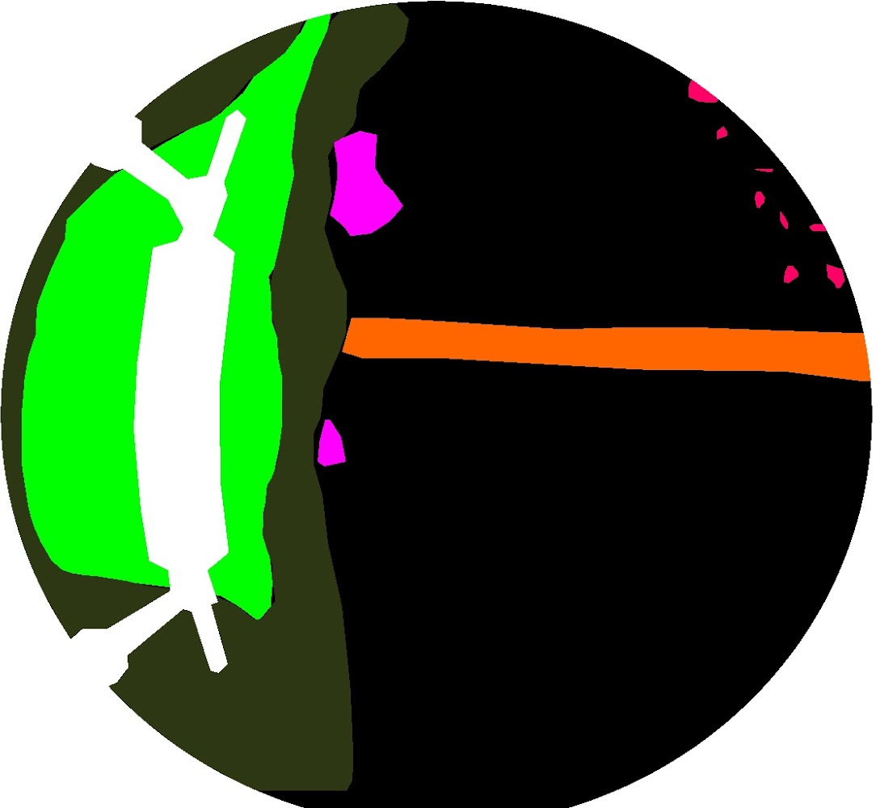
Vision-based Penstock Inspection
Problem formulation: supervised semantic image segmentation
Object of interest: corroded spots (in pink, red)
Notes:
Number of classes
Use deep neural network

Slide 24
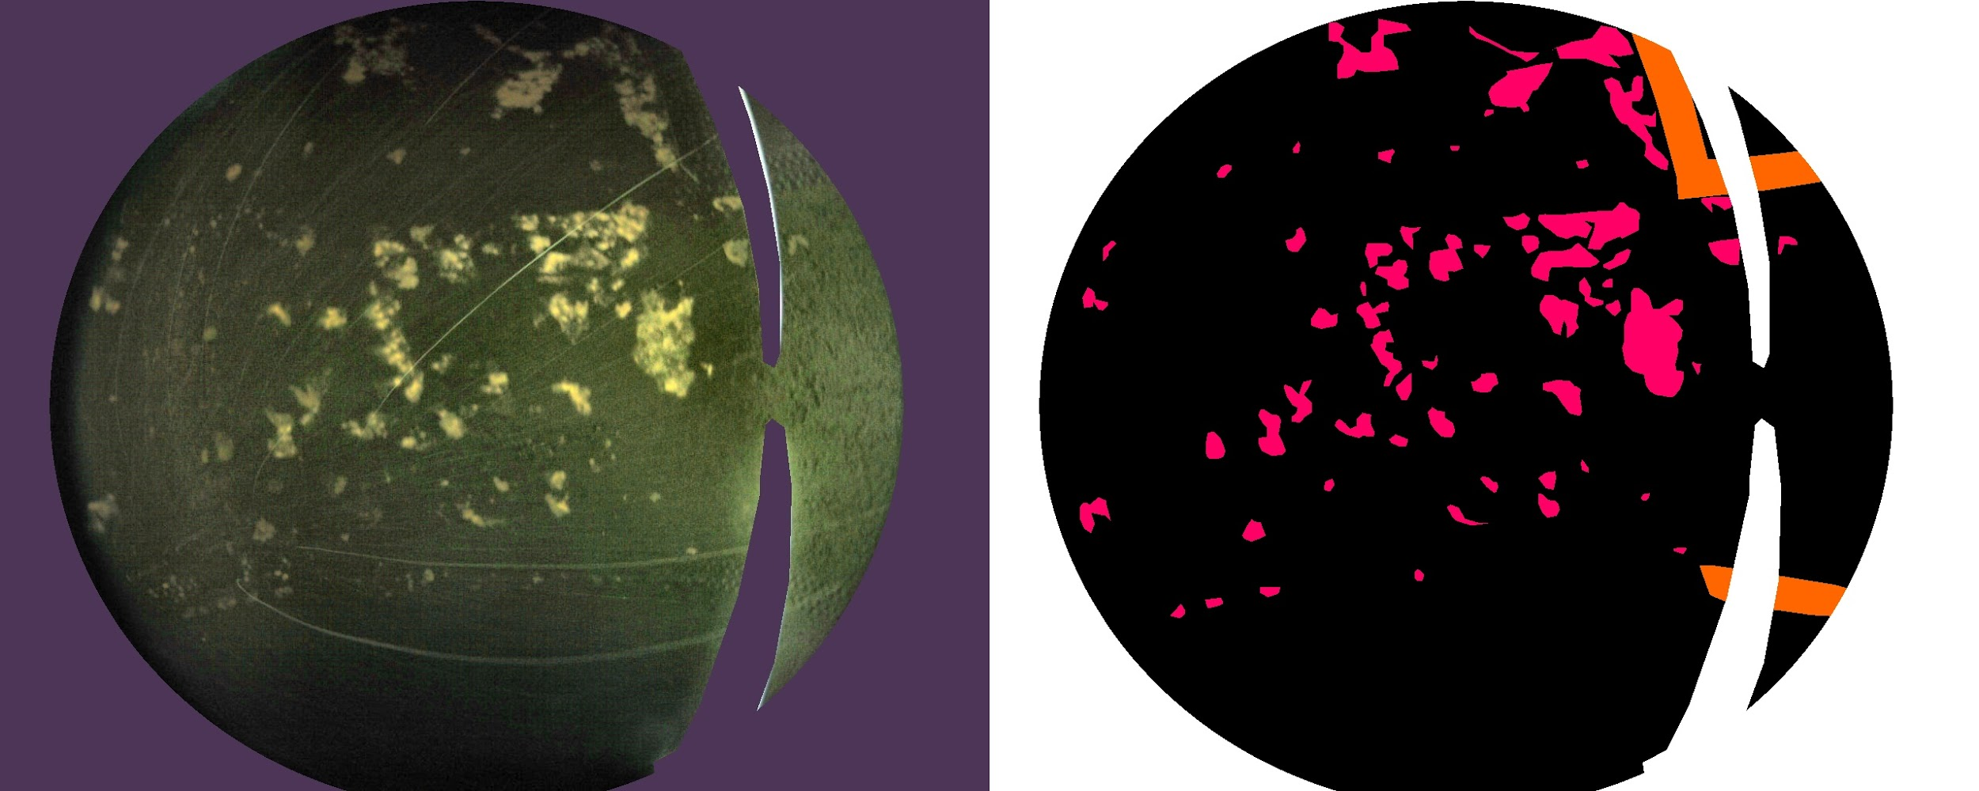
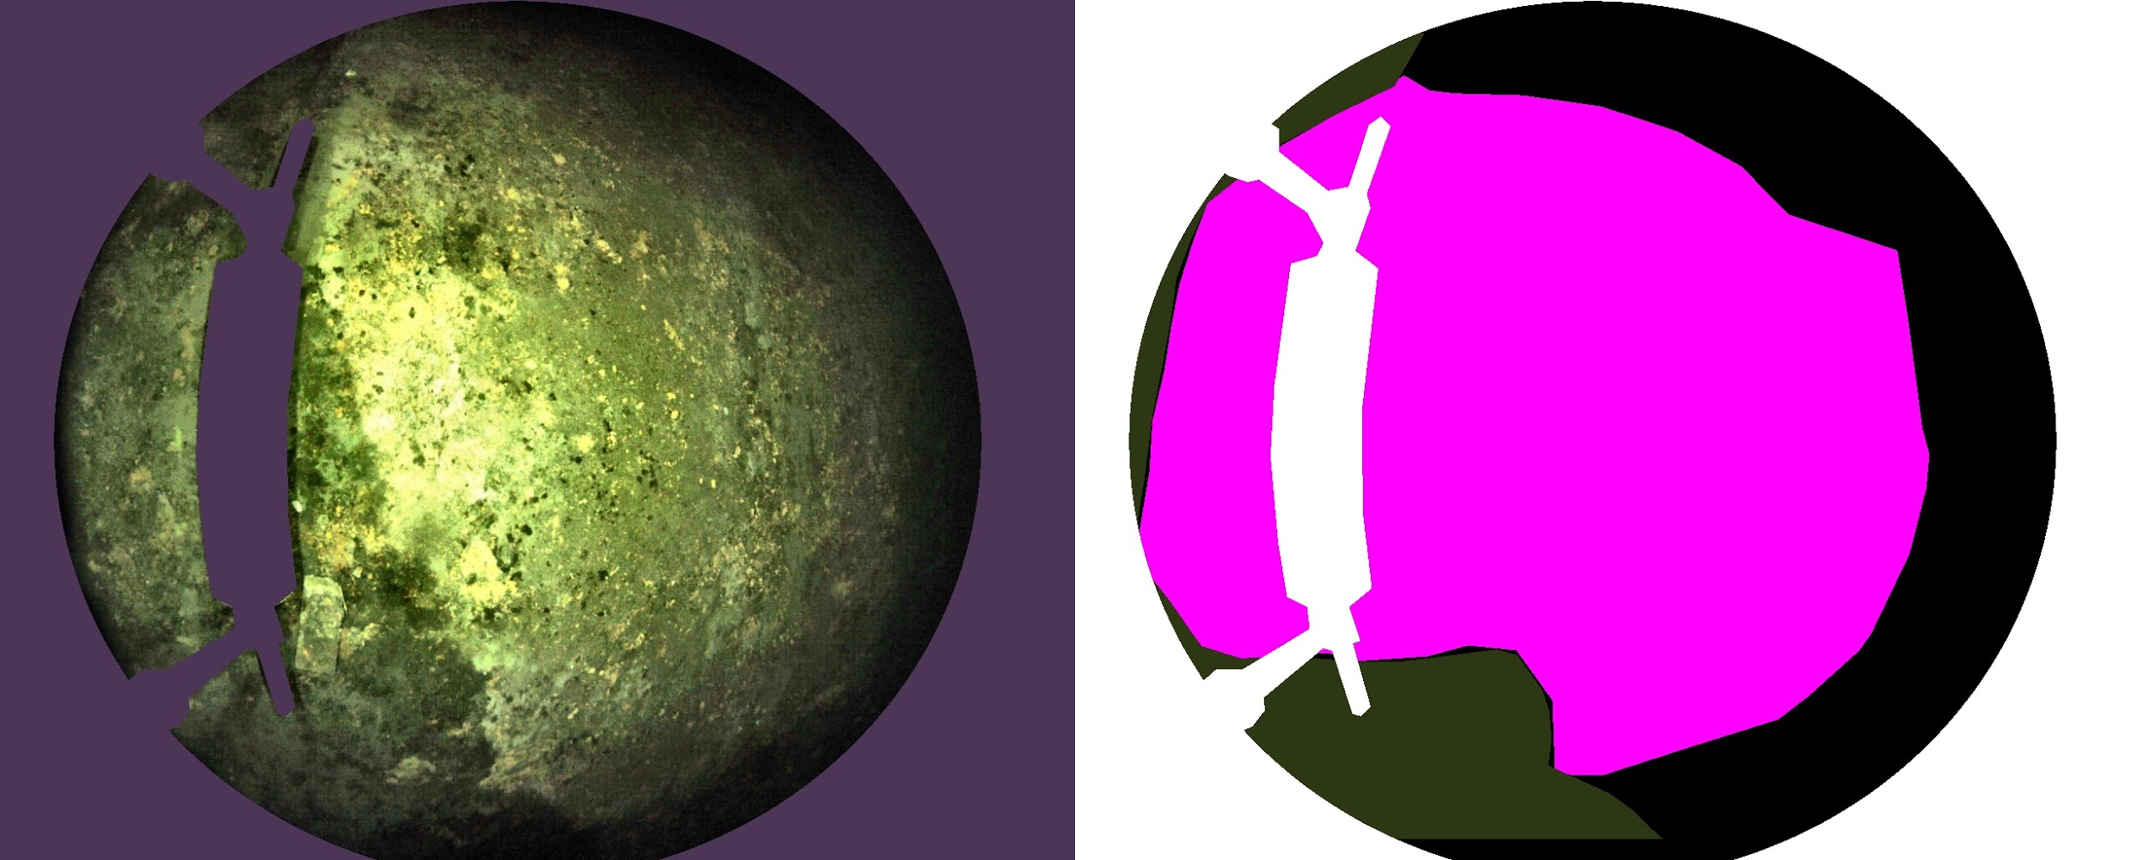
Challenges
Object variance in size & appearance
Use full image size
Semantic segmentation: associate each pixel with a class label
Uncertainty in human-labelling
Use class weight to mitigate effect of wrong labeled pixels

Slide 25
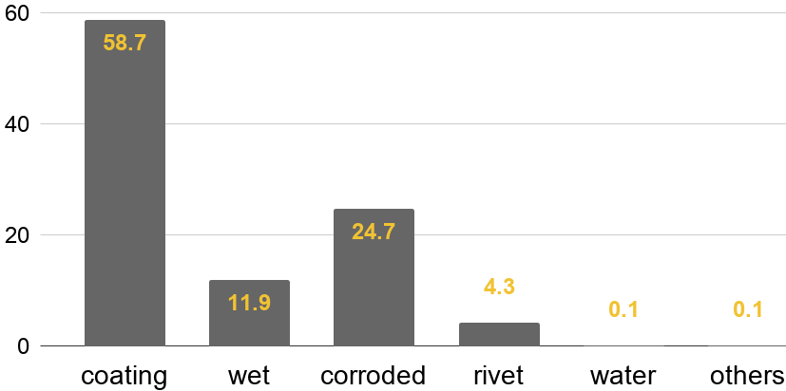
Challenges
Class Imbalance
Utilize focal loss & class weights
Class Distribution in Training Dataset (%)
Notes:
Class weights are actually priors

Slide 26
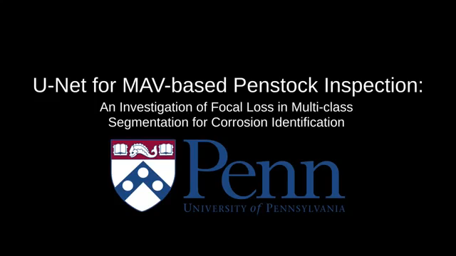
Results

Slide 27
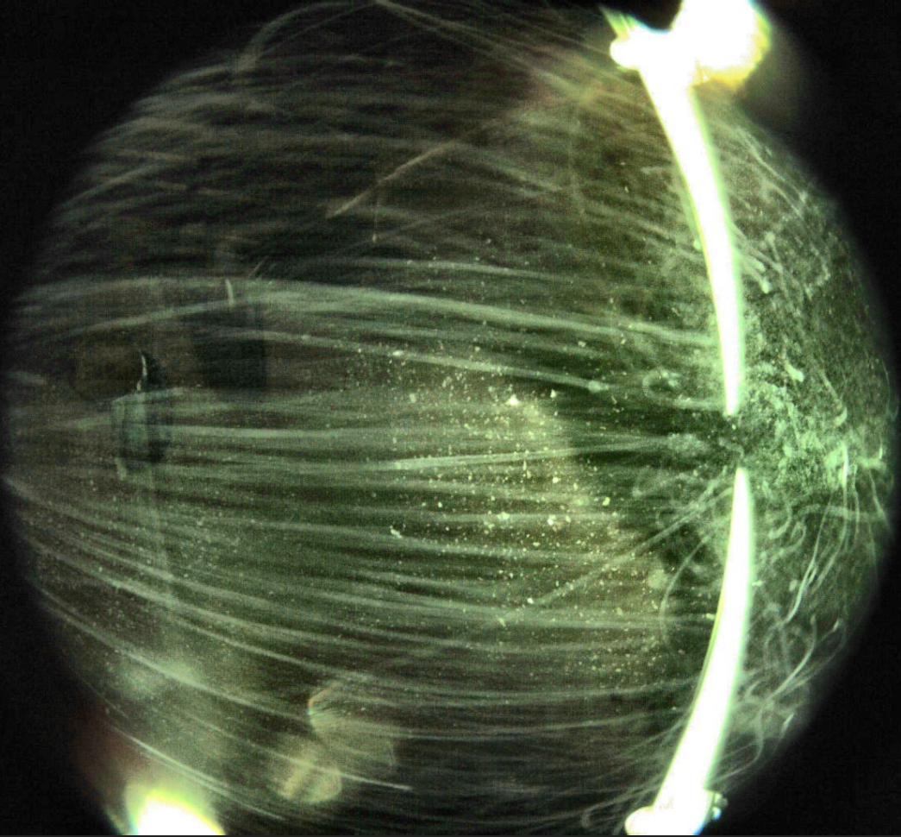
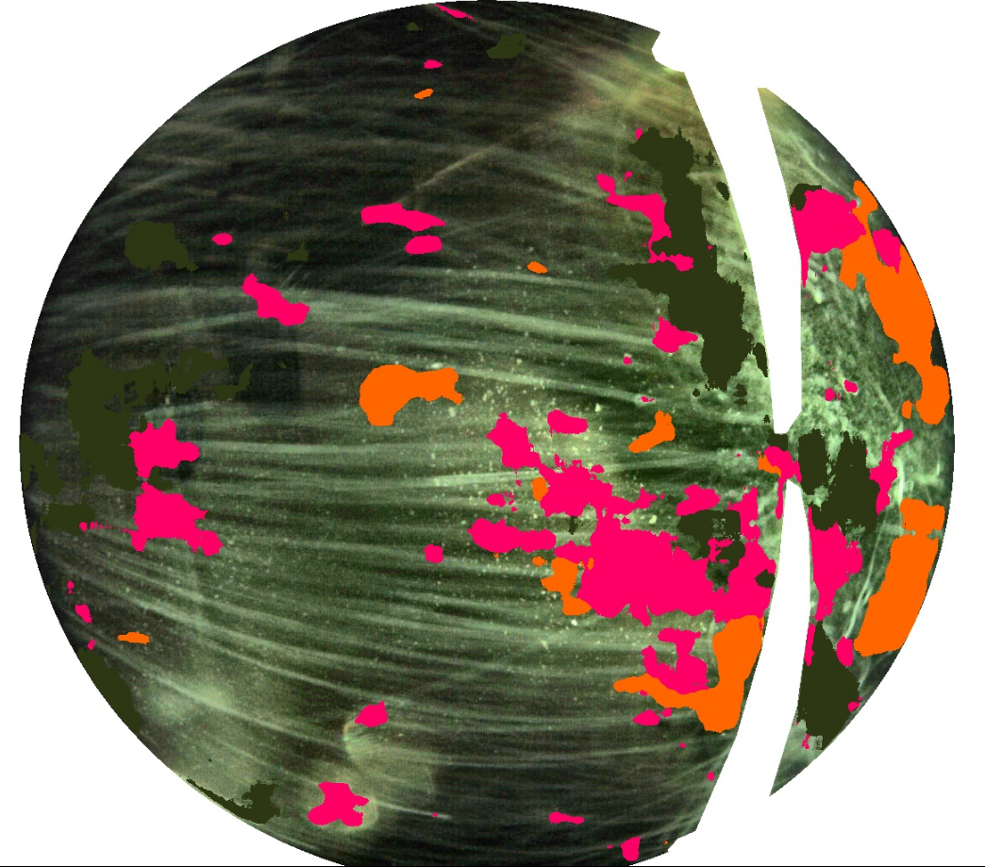
Remained Challenges
Dust noise

Slide 28
Main Topics
Introduction
Vision-based Robotics Applications (Examples)
Visual Odometry
Object Detection & Segmentation for Inspection
Challenges
Resource Limitation
Real Time Inference
Sparse Inputs
Efficient Convolution
Dilated Convolution
Deformable Convolution
Continuous Convolution

Slide 29
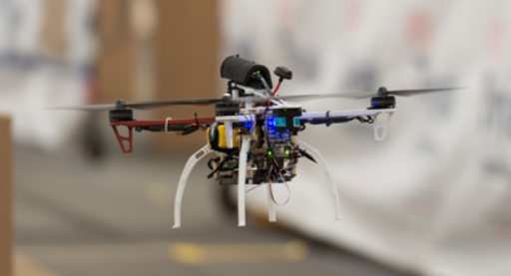

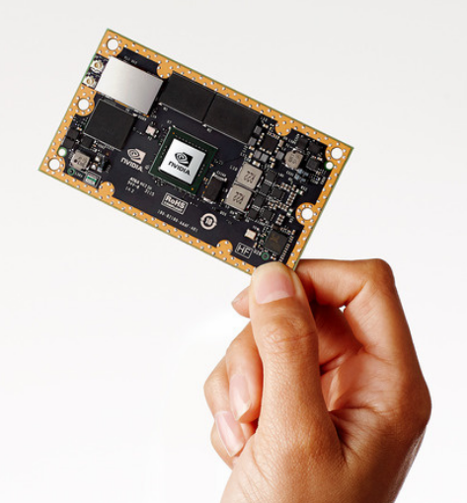
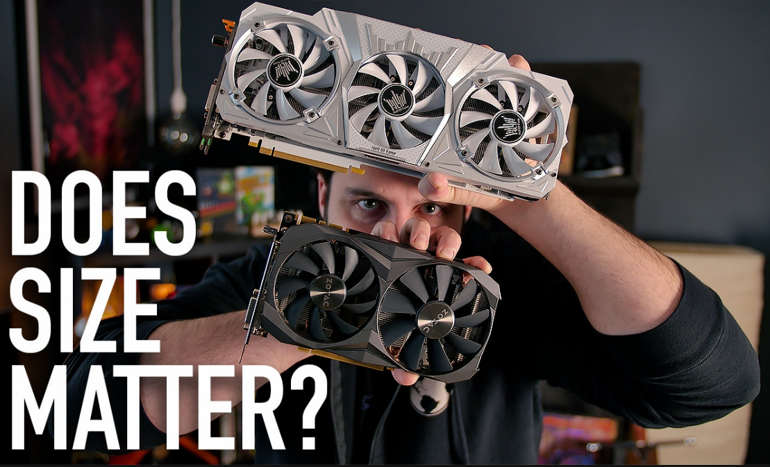
Robotic Vision Challenges
There are multiple characteristics from which robotic vision distinguish itself from machine vision
Unlike machine vision, robotic vision is much more subject to onboard computation resource: limited carrying weight & battery life => limited resources
Geforce GTX
Tegra X2
11x less powerful!

Slide 30
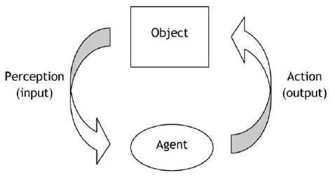

Robotic Vision Challenges
Unlike machine vision, robotic vision is subject to real time running, given limited resource: action in real time if and only if perception in real time.
11x less powerful!

Slide 31
Robotic Vision Challenges
Dilemma in Robotic Vision:
Slow response (time)
Heavy (sensor weights) Expensive (sensor cost)
Short (range)
Dense sensory signal
Fast response (time)
Light (sensor weights)
Cheap (sensor cost)
Long (range) for fast reaction
Robotics applications requirements
Can we provide fast, reliable information based on sparse sensory signals?

Slide 32
Main Topics
Introduction
Vision-based Robotics Applications (showcases)
Visual Odometry
Object Detection & Segmentation for Inspection
Challenges
Resource Limitation
Real Time Inference
Sparse Inputs
Efficient Convolution
Dilated Convolution (not include yet)
Deformable Convolution
Continuous Convolution

Slide 33
Deformable Convolutional Networks*
Motivation: CNNs are inherently invariant to large and unknown transformation and relies on data augmentation to learn geometric transformation. In fully convolutional network (FCNs), being able to dynamically adjust receptive field is especially desirable.
*Dai, J., Qi, H., Xiong, Y., Li, Y., Zhang, G., Hu, H. and Wei, Y., 2017. Deformable convolutional networks. CoRR, abs/1703.06211, 1(2), p.3.

Slide 34

Deformable Convolution: Introduction
Adds 2D offsets to the regular grid sampling locations in the standard convolution.
Enables free form deformation of the sampling grid.

Slide 35

Deformable Convolution: Introduction
A deformable convolution consists of 2 parts: regular conv. layer and another conv. layer to learn 2D offset for each input.
Can think of deformable convolution as a “learnable” dilated (atrous) convolution which the dilated rate is learned and can be different for each input.
The channel dimension 2N corresponds to N 2D offsets.
Notes:
During training, both the convolutional kernels for generating the output features and the offsets are learned simultaneously.

Slide 36

Deformable Convolution: Introduction
In this diagram, the regular conv. layer is fed in the blue squares instead of the green squares.
Notes:
During training, both the convolutional kernels for generating the output features and the offsets are learned simultaneously.

Slide 37



Deformable Convolution: Math
Standard 2D convolution:
1) sampling using a regular grid over the input feature map x;
2) summation of sampled values weighted by w.
The grid defines the receptive field size and dilation
A
In deformable convolution, the regular grid is augmented with offsets
Output feature map y

Slide 38


Deformable Convolution: Math
Output feature map y
The offset ∆p_{n} is typically fractional, above Eq. is implemented via bilinear interpolation as
Where p denotes an arbitrary (fractional) location, q enumerates all integral spatial locations in the feature map x, and G(·, ·) is the bilinear interpolation kernel
G is two dimensional. It is separated into two one dimensional kernels as

Slide 39

Deformable Convolution: Effect on Receptive Field
Deformable convolution is able to “expand” the receptive field for bigger object.
Quantitatively measure “effective dilation” which is the mean distances between each offsets
Found that deformable filters that are centered on larger objects has larger “receptive field”.

Slide 40


Deformable Convolution: Effect on Receptive Field
Figure 6: Each image triplet shows the sampling locations (9^3 = 729 red points in each image) in three levels of 3 × 3 deformable filters (see Figure 5 as a reference) for three activation units (green points) on the background (left), a small object (middle), and a large object (right), respectively.

Slide 41
Deformable Convolution: Usage
Deformable convolution is easy to integrate into any CNN architectures.

Slide 42
Deformable Convolution: Conclusions
Deformable convolution is a generalization of atrous convolution
They add small amount of parameters and computation for the offset learning.
They can readily replace their plain counterparts in deep CNNs and can be easily trained end-to-end with standard backpropagation

Slide 43
Continuous convolution

Slide 44

Continuous Convolution*
Motivation: Discrete convolutions relies on dense grid structure (e.g., 2D grid for images, 3D grid for videos). However, many real world applications such as visual perception from 3D point clouds, mesh registration and non-rigid shape correspondences rely on making statistical predictions from non-grid structured data.
A point cloud example from Apolloscape Dataset
*Wang, S., Suo, S., Pokrovsky, W.C.M.A. and Urtasun, R., 2018. Deep parametric continuous convolutional neural networks. In Proceedings of the IEEE Conference on Computer Vision and Pattern Recognition (pp. 2589-2597).
Simplest approach: voxelize the space to form a grid where standard discrete convolutions can be performed . However, most of the volume is typically empty => memory inefficiency and wasted computation.

Slide 45

(Parametric) Continuous Convolution: Introduction
A parameterized kernel function that spans the full continuous vector space.
In this way, it can handle arbitrary data structures as long as its support relationship is computable.

Slide 46





(Parametric) Continuous Convolution: Math
Standard CNNs use discrete convolutions
Continuous convolutions can be defined as
1st Problem: integration is analytically intractable for real-world applications: input features are complicated and non-parametric, and observations are sparse points sampled over the continuous domain
Solution: use monte-carlo integration

Slide 47




(Parametric) Continuous Convolution: Math
Let be the input feature
be associated locations in the input domain be associated locations in the output domain
Each element of the output feature vector is then computed as
Where , kernel function
is evaluated for every x_{j} y_{i}
N: the number of input points, M be the number of output points, and D the dimensionality of the support domain.
F and O predefine input and output feature dimensions respectively.

Slide 48

(Parametric) Continuous Convolution: Layer Details

Slide 49

(Parametric) Continuous Convolution: Network

Slide 50

(Parametric) Continuous Convolution: Results

Slide 51
Questions?

